Slide 1



Amazon Sales
Analysis
Presented By
Student Name: Samenu shyamsundar
College Name: Khallikote unitary university
Department: B.sc. Computer science
Email ID: samenushyam65@gmail.com

Slide 2
OUtline AMAZON SALES ANALYSIS
Data Source
Table: Amazon_sales with a supporting DateTable
Key Fields:
product_category, customer_region, payment_method
total_revenue, profit, quantity_sold, discount_percent
rating, review_count
Date dimensions: Year, Quarter, Month

Slide 3
Problem Statement:
Amazon, as a large-scale e-commerce platform, generates vast volumes of transactional data across multiple product categories, regions, and customer segments. However, without structured analysis, this data remains underutilized — making it difficult for business stakeholders to identify performance gaps, optimize pricing strategies, or allocate resources effectively.

Slide 4
Proposed Solution:
The proposed system aims to address the challenge of analyzing and visualizing Amazon sales data to ensure accurate tracking of revenue, profit, regional performance, and product demand. This involves leveraging data analytics and interactive visualization techniques to uncover actionable business insights. The solution consists of the following components:
Data Collection
Gather historical Amazon sales transaction data including product category, customer region, payment method, quantity sold, revenue, profit, discount percentage, and customer ratings from Kaggle.
Utilize supporting data sources such as a structured Date Table to enable time-based analysis across Year, Quarter, and Month dimensions.
Incorporate product-level metadata including review counts and ratings to support performance benchmarking.
Data Preprocessing
Clean and preprocess the collected data to handle missing values, outliers, and data type inconsistencies within Power Query Editor.
Apply feature engineering to derive calculated columns and DAX measures such as Total Revenue, Total Profit, Average Rating, and Top N Product rankings.
Establish relationships between the sales table and date table to enable accurate time intelligence and cross-filtering across all report pages.
Deployment
Develop a user-friendly, multi-page Power BI Dashboard that provides real-time interactive insights into sales trends, regional performance, discount impact, and product rankings.
Deploy the solution on Power BI Service — a scalable and reliable cloud platform — ensuring accessibility across devices with role-based sharing and scheduled data refresh.
Incorporate slicers, navigation buttons, and cross-filtering to allow non-technical stakeholders to explore data independently without requiring SQL or coding knowledge.

Slide 5
System Approach:
The System Approach outlines the overall strategy and methodology for developing and implementing the Amazon Sales Analysis dashboard.
System Requirements
Microsoft Power BI Desktop is required to build and run this project, and a stable internet connection for publishing to Power BI Service.
Libraries & Features Required to Build the Model
Power BI's built-in suite of tools is utilized to develop this solution, including Power Query Editor for data cleaning and transformation, Filters for create a table of top-3 products by Average Rating and Quantity Sold , Data Modeling for establishing relationships between the Amazon_sales and DateTable, and core visuals such as Map, Donut Chart, Bar Chart, Scatter Chart, Line Chart, Card Visual, Slicers, and Navigation Buttons to build the complete 4-page interactive dashboard.

Slide 6
Result:
The Amazon Sales Analysis Power BI dashboard successfully delivered a comprehensive, interactive, and visually appealing 4-page report that transforms raw Amazon sales data into meaningful business insights. The Overview page provides a high-level summary of total revenue, profit trends over time, and category-wise performance through cards, line charts, and column charts. The Regional Analysis page identifies geographic revenue distribution across customer regions using map visuals, donut charts, and bar charts. The Payment & Discount page uncovers the relationship between discount percentages and profitability, along with payment method preferences through scatter charts and donut charts. Finally, the Product Performance page benchmarks top products by average rating and quantity sold using detailed tables and line charts — collectively enabling stakeholders to make data-driven decisions on sales strategy, regional targeting, pricing optimization, and product prioritization.

Slide 7
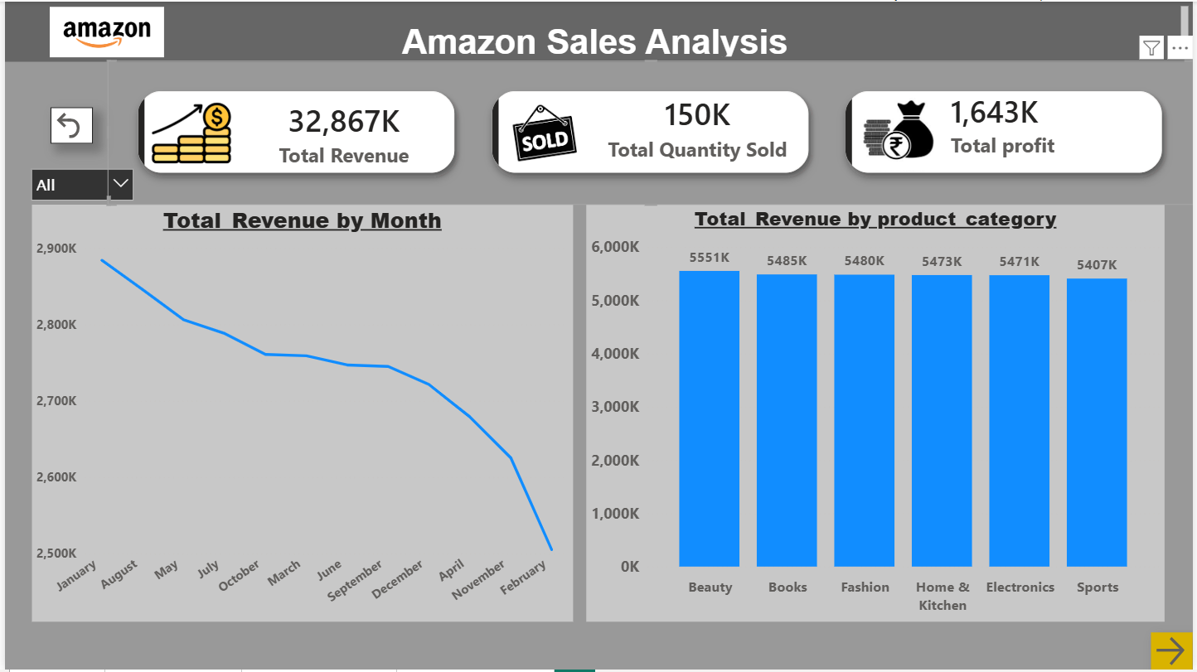
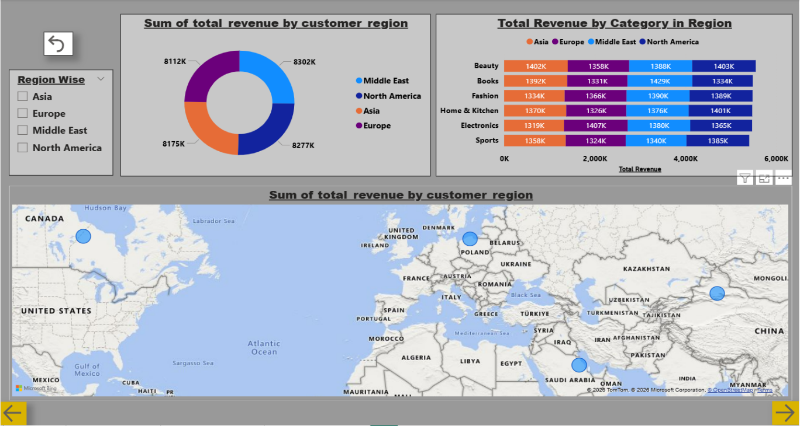
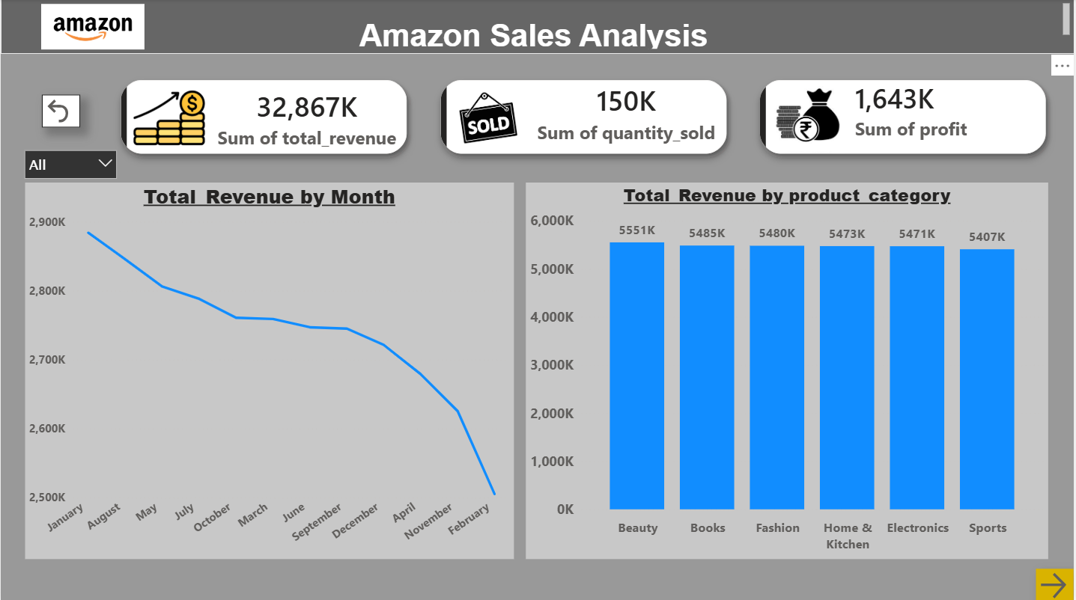
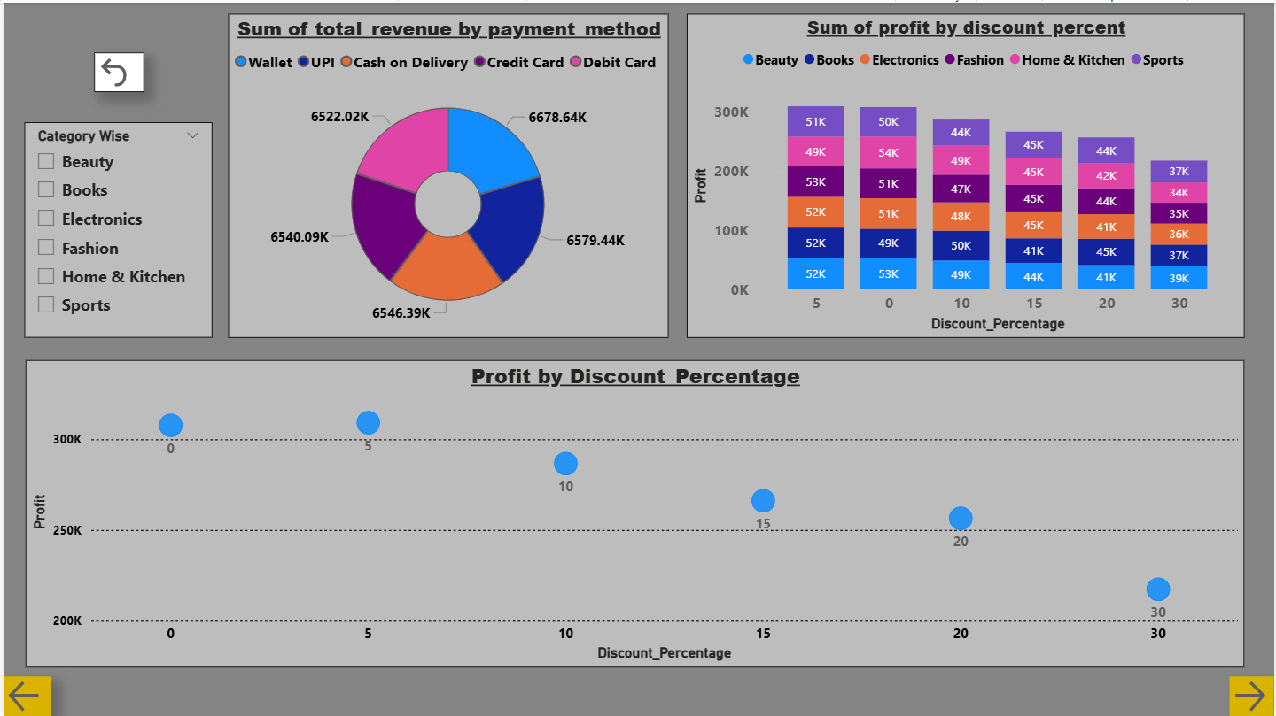
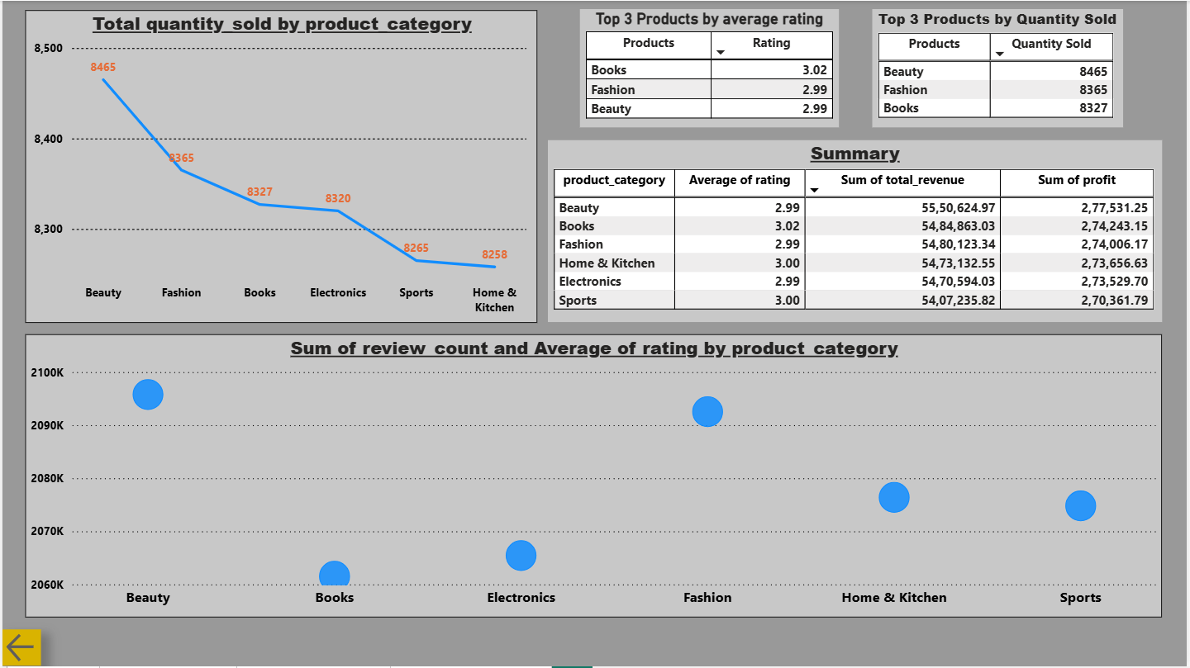

Slide 8
Conclusion:
The Amazon Sales Analysis Power BI dashboard successfully transforms raw Amazon sales data into clear, actionable insights across four key dimensions — revenue trends, regional performance, payment behavior, and product benchmarking. By leveraging Power Query, DAX measures, and interactive visuals, the solution empowers stakeholders to monitor business health, identify high-performing regions and products, and optimize discount strategies in real time. The dashboard serves as a centralized decision-making platform that simplifies complex data, enabling business teams to drive revenue growth and improve overall operational efficiency effectively.

Slide 9
Future scope:
The Amazon Sales Analysis dashboard can be further enhanced by integrating machine learning models to predict future sales trends and product demand. Incorporating customer demographic data and real-time data streaming via Power BI Service would enable deeper segmentation and up-to-date insights. Adding competitor pricing analysis and seasonal trend integration would make the solution a truly comprehensive, future-ready business intelligence platform.

Slide 10
References:
Kaggle Dataset Link: https://www.kaggle.com/datasets/litonislam/amazon-sales-analysis-cleaned-data/data
GitHub Link: https://github.com/samenushyam65-eng/Amazon-Sales-Analysis-.git
Drive Link: https://drive.google.com/drive/folders/1NrHoPlRf9RKj1BgCA80F2NWfED-XXVCj?usp=drive_link

Slide 11
Thank You

